Slide 1
Machine Learning for data science and business intelligence – 8IAR403
By Kévin Bouchard Ph.D.
Professor in artificial intelligence & machine learning
Laboratoire d'Intelligence Ambiante pour la reconnaissance d'activités (LIARA)
Université du Québec à Chicoutimi
www.Kevin-Bouchard.ca
Kevin_Bouchard@uqac.ca

Slide 2

Summary of lesson #5
You will learn about:
A second neuron model called ADALINE
About cost functions and their optimization
But don’t worry, just a quick, simple introduction!
How to use these model in the case of multiple classes

Slide 3
Adaptive Linear Neurons
Adaline: is another type of artificial neural network
It has a different, more useful activation function
It is trained using a cost function

Slide 4
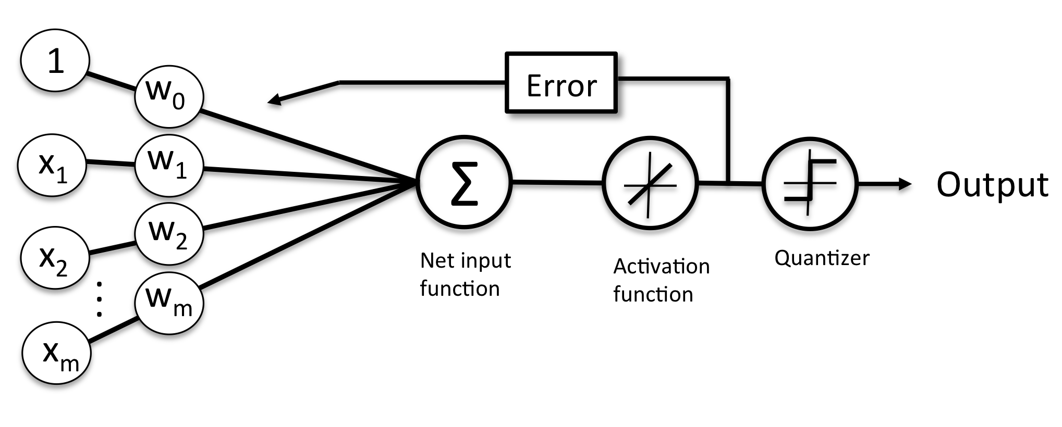
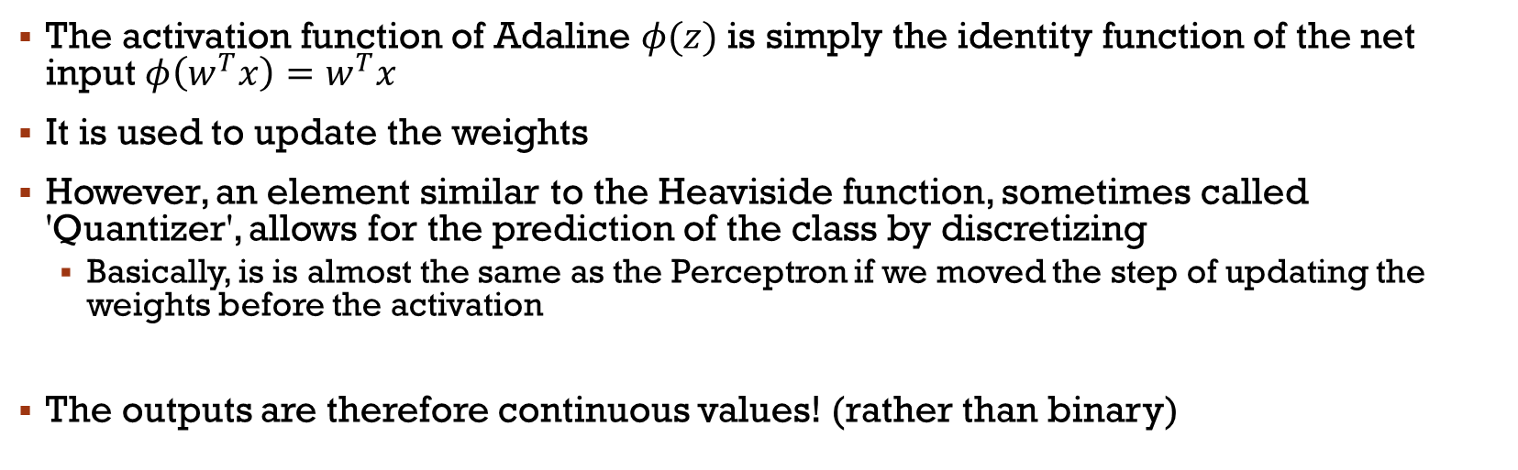
Adaline
The activation function of Adaline $φ(z)$ is simply the identity function of the net input$φ\left(w^{T}x\right)=w^{T}x$
It is used to update the weights
However, an element similar to the Heaviside function, sometimes called 'Quantizer', allows for the prediction of the class by discretizing
Basically, is is almost the same as the Perceptron if we moved the step of updating the weights before the activation
The outputs are therefore continuous values! (rather than binary)
Notes:
Est-ce toujours de la classification? Oui

Slide 5
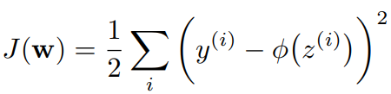
Cost function
Key concept in ML
Most often, we optimize an objective function
You probably won’t see it, since it happens behind the scene
This isn’t an optimization class, but it seems important to give you an idea of how it works
For Adaline, the cost function to minimize is the Sum of Squared Errors (SSE)
It measures the error of the model, and therefore, we want to minimize it
*The ½ is added to facilitate the calcul of a derivative (1/n classes)
Notes:
The cost function represents the total penalty that a model incurs for its predictions on the entire training dataset.
Essentially, it’s the sum (or average) of the individual losses over the entire dataset, which the training algorithm will attempt to minimize.

Slide 6


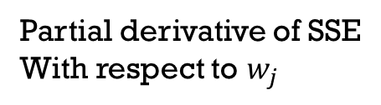
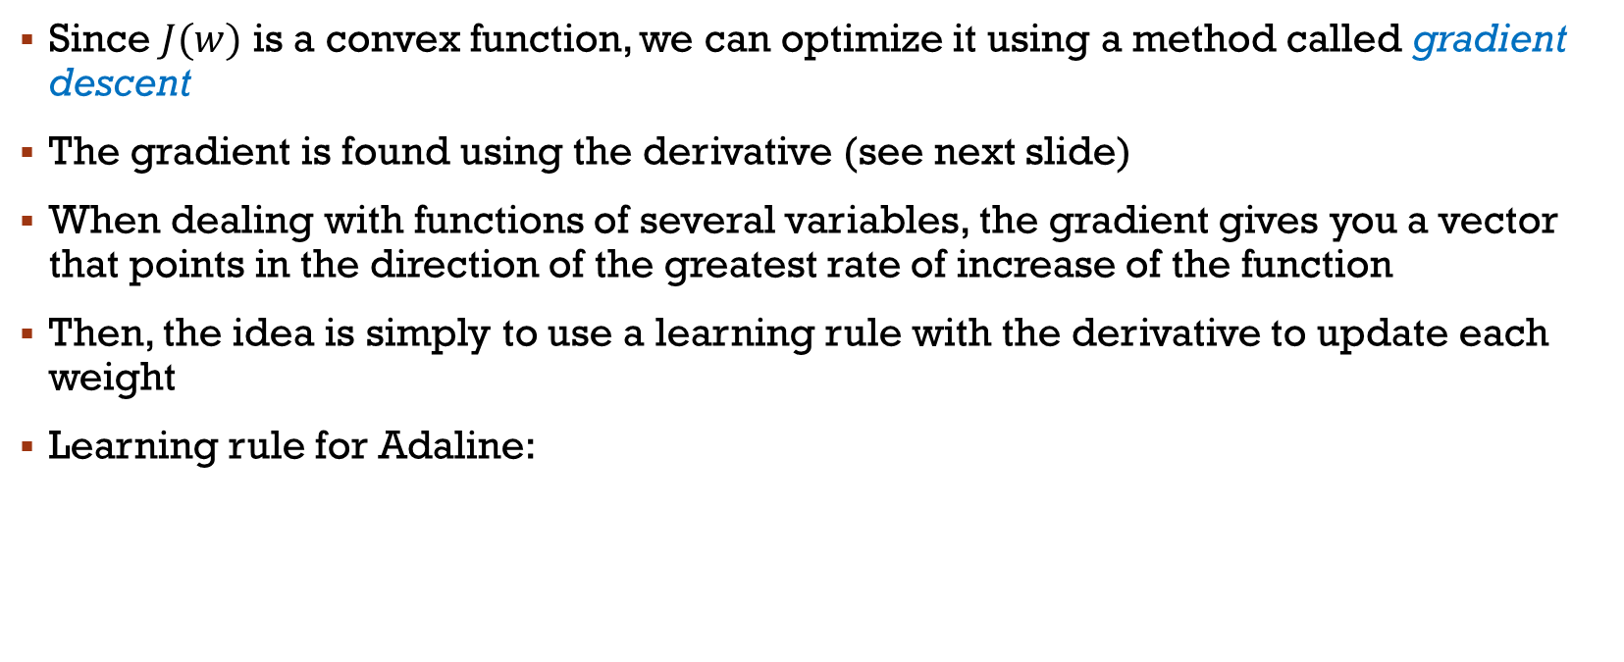
Algorithme du Gradient
Since $J(w)$ is a convex function, we can optimize it using a method called gradient descent
The gradient is found using the derivative (see next slide)
When dealing with functions of several variables, the gradient gives you a vector that points in the direction of the greatest rate of increase of the function
Then, the idea is simply to use a learning rule with the derivative to update each weight
Learning rule for Adaline:
Negative step because
we minimize SSE
Partial derivative of SSE
With respect to $w_{j}$
Notes:
Différentiable
La majorité sont non-convex

Slide 7
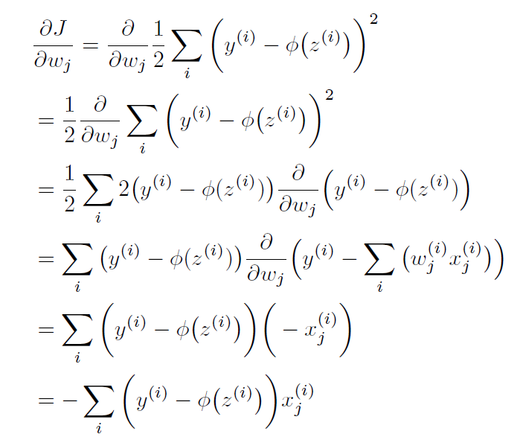
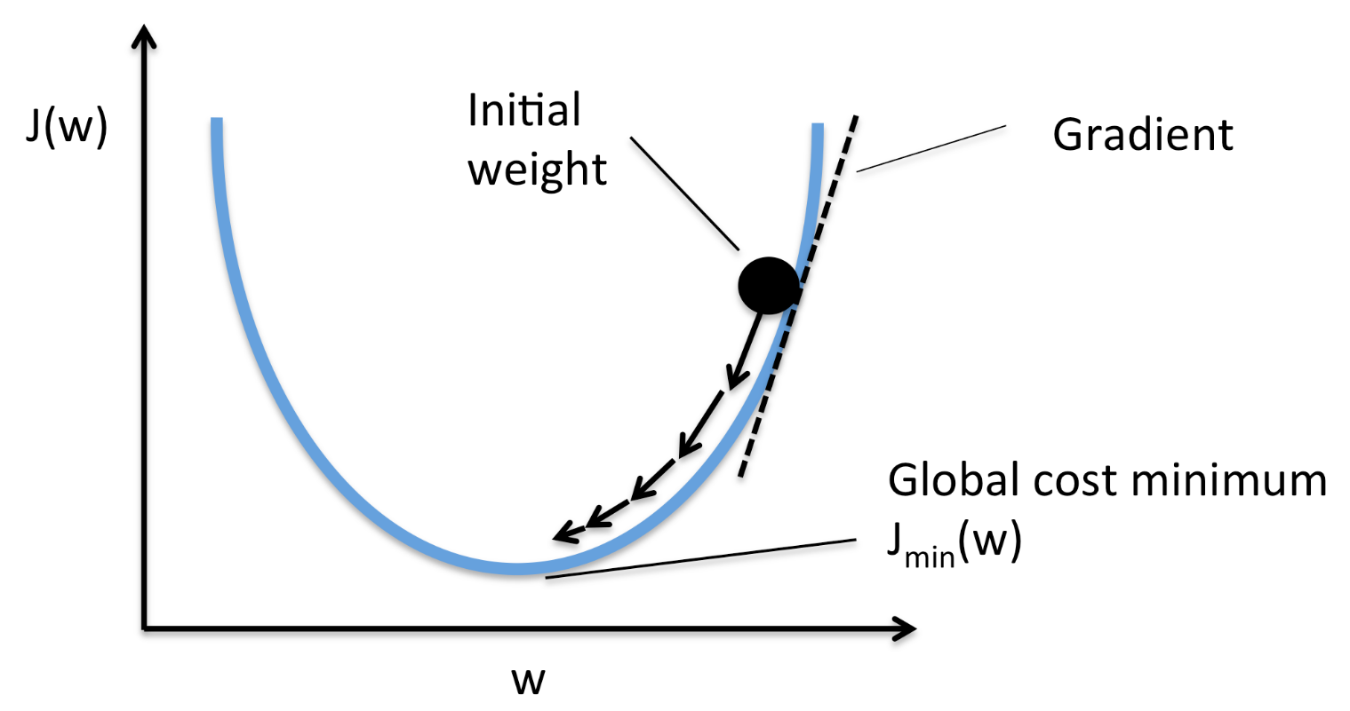
SSE and its derivative
Step by step calculations for the derivative

Slide 8
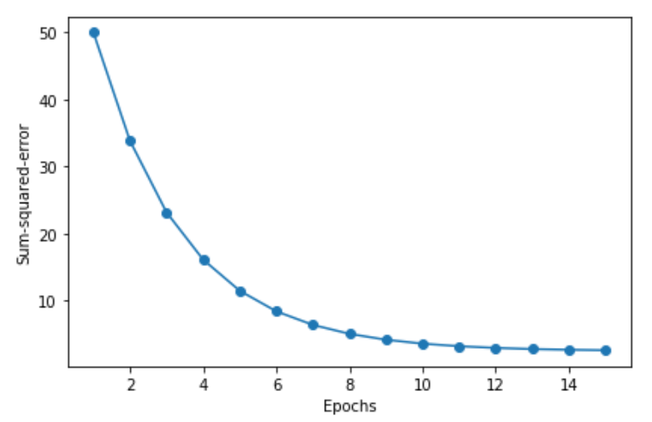
Gradient
Top: Visualization of what is happening
Bottom: SSE for each epoch
*Image
towardsdatascience.com
Notes:
SSE: sum of suqared error

Slide 9
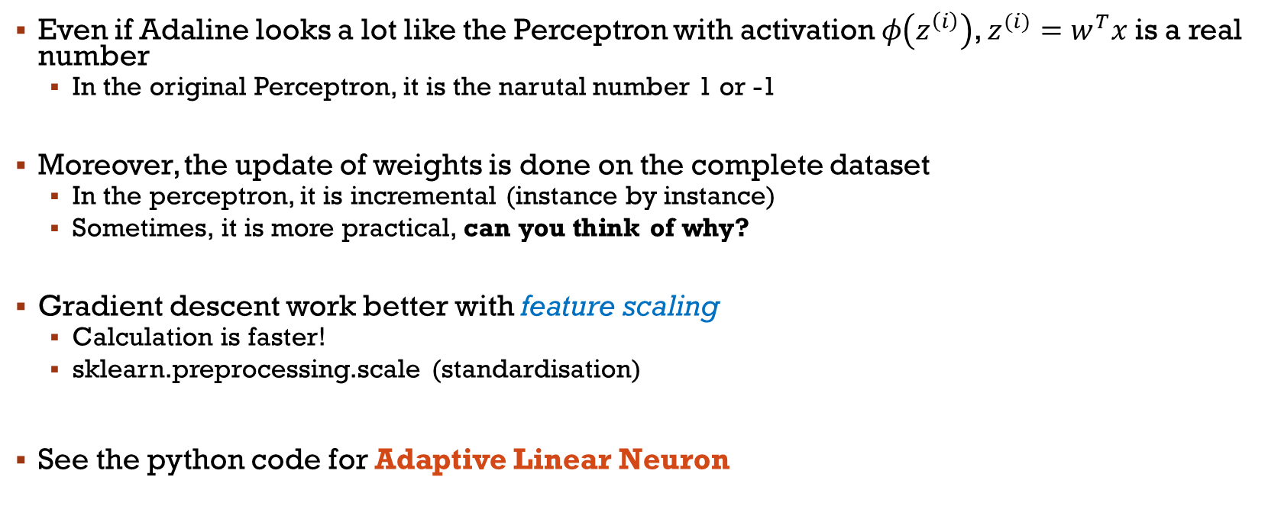
Summary
Even if Adaline looks a lot like the Perceptron with activation $φ\left(z^{\left(i\right)}\right)$, $z^{(i)}=w^{T}x$ is a real number
In the original Perceptron, it is the narutal number 1 or -1
Moreover, the update of weights is done on the complete dataset
In the perceptron, it is incremental (instance by instance)
Sometimes, it is more practical, can you think of why?
Gradient descent work better with feature scaling
Calculation is faster!
sklearn.preprocessing.scale (standardisation)
See the python code for Adaptive Linear Neuron
Notes:
feature scaling – Standardise les valeurs de features
Show Adaline code, not SGD…

Slide 10
Let’s go a bit further
We’ll now talk about a few thing to get to know more about neural network
Then, we’ll take a look at the vast diversity of models in lesson 5 and 6

Slide 11
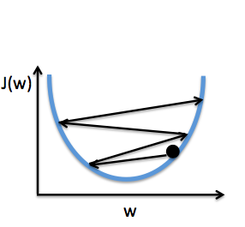
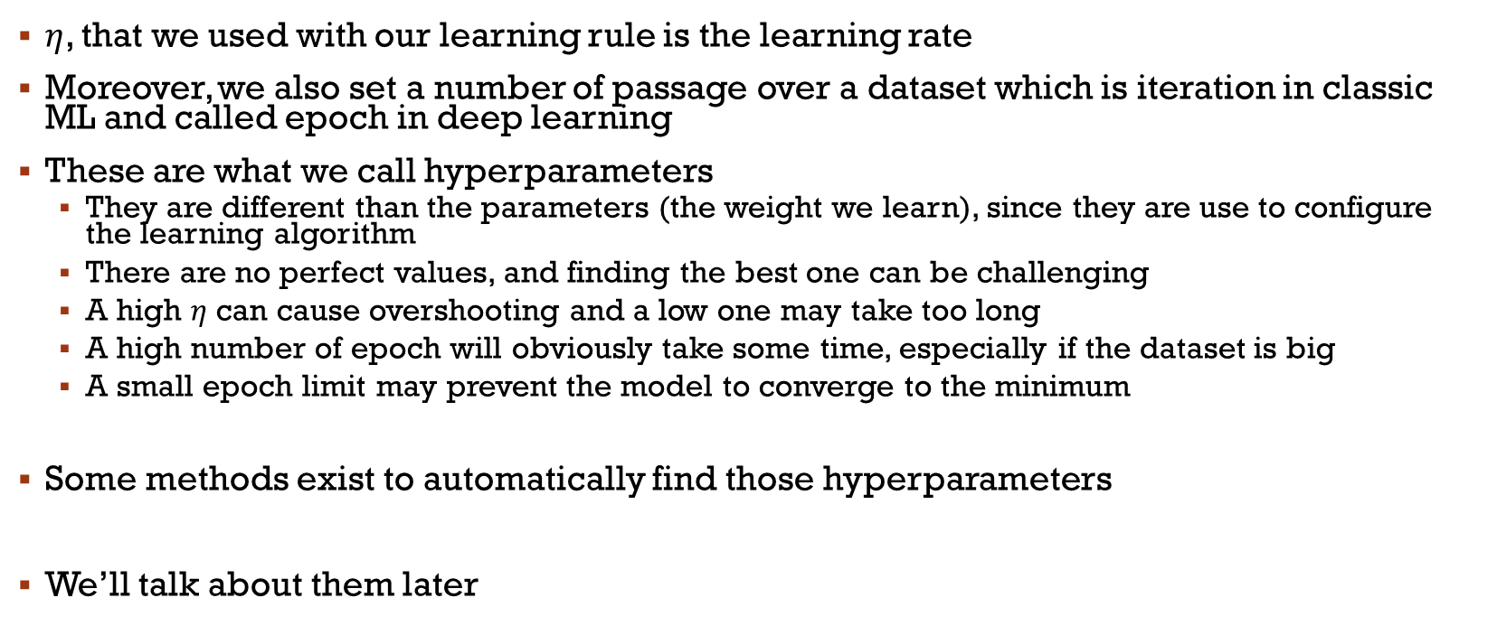
Hyperparameters
$η$, that we used with our learning rule is the learning rate
Moreover, we also set a number of passage over a dataset which is iteration in classic ML and called epoch in deep learning
These are what we call hyperparameters
They are different than the parameters (the weight we learn), since they are use to configure the learning algorithm
There are no perfect values, and finding the best one can be challenging
A high $η$ can cause overshooting and a low one may take too long
A high number of epoch will obviously take some time, especially if the dataset is big
A small epoch limit may prevent the model to converge to the minimum
Some methods exist to automatically find those hyperparameters
We’ll talk about them later
Notes:
Img: overshoot, high learning rate
Code example for overshoot

Slide 12


Stochastic Gradient Descent
We have seen how to minimize a cost function with a gradient calculated from the complete set.
Difficult if we have millions of instances!
Reevaluation of the entire set at each step (!!!)
More popular in ML:
Stochastic Gradient Descent (sometimes iterative or online)
Incrementing the weights for each sample of the training set!
Well, actually, in general, a batch of samples
Notes:
Become a loss function… computed over only one or few data points

Slide 13
Stochastic Gradient Descent
It is an approximation of the gradient algorithm
Converges more quickly in general! (more updates)
The error contains more noise
IMPORTANT: Data must be presented in a random order to obtain good results
Since we calculate on each sample without resetting to 0
The learning rate is often adaptive with SGD (as in simulated annealing methods)
See updated Adaline code with SGD (fit, partial_fit et shuffle)
Notes:
Usable for Big Data and online learning
We usually do Mini-Batch

Slide 14
What is an ideal optimizer for ML?
Speed of convergence: Some optimizers converge faster than others, which can be crucial when dealing with very large datasets
Memory requirements: Some optimizers, like Adam, maintain momentum and second-moment estimates for each parameter, which can be memory-intensive for large models
Ease of tuning: Some optimizers have hyperparameters that are more intuitive to tune than others
Robustness: Certain optimizers are more robust to the choice of hyperparameters, initialization, and noise in the data
The concept of an "ideal" optimizer does not exist in an absolute sense because the effectiveness of an optimizer can significantly depend on
the specific problem
the structure of the model,
the nature of the dataset
the desired balance between speed of convergence and the quality of the resulting model
Notes:
Simply talk about SGD being good, but imperfect

Slide 15
Optimizers in well-known libraries
Only a few choices in Scikit-Learn: https://scikit-learn.org/stable/modules/neural_networks_supervised.html
A lot more with Tensorflow: https://www.tensorflow.org/api_docs/python/tf/keras/optimizers
Adam et RMSProp sont particulièrement populaires
PyTorch offre encore plus de choix que Keras: https://pytorch.org/docs/stable/optim.html

Slide 16




Multiple classes?
There are very few natural binary classification problems in the real world compared to their multiclass counterpart
Binary classification algorithms such as the Perceptron & Adaline can be extended to multi-class problems by various strategies

Slide 17
One-vs-ALL
The One-vs-All approach consists of creating a classifier for each class, where every other instance is considered of the negative class
The classification then consists of passing a new example through all the classifiers in order to find the one that triggers
Caution! In general, it is rather preferred to have an output in terms of confidence level where we look for the max
Difficult with poorly balanced data
Difficult to ensure that the range of confidence levels does not vary too much from one classifier to another
Notes:
Example on why balanced data become a problem
Example on taking a decision using 3 classifiers

Slide 18
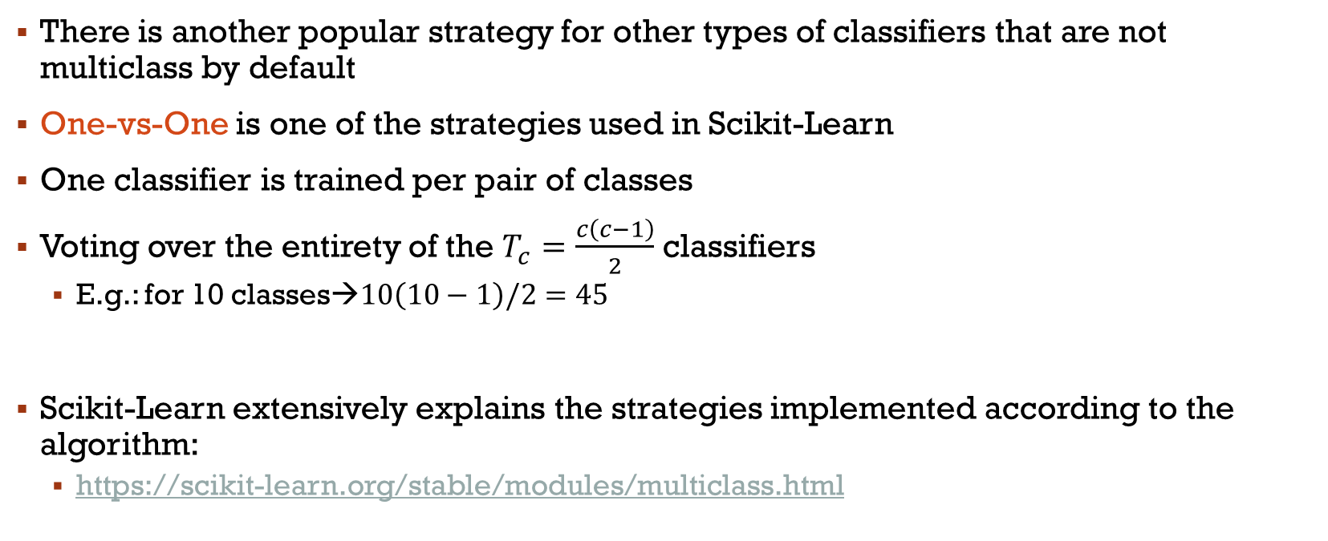
One-vs-One
There is another popular strategy for other types of classifiers that are not multiclass by default
One-vs-One is one of the strategies used in Scikit-Learn
One classifier is trained per pair of classes
Voting over the entirety of the $T_{c}=\frac{c\left(c−1\right)}{2}$ classifiers
E.g.: for 10 classes→$10\left(10−1\right)/2=45$
Scikit-Learn extensively explains the strategies implemented according to the algorithm:
https://scikit-learn.org/stable/modules/multiclass.html
Notes:
Check the link to quickly show them the models!

Slide 19
Main References
Russell S., Norvig P., Artificial Intelligence: A Modern Approach. Prentice-Hall, Englewood Cliffs, 2021.
Aggarwal, C. C., Neural networks and deep learning. Springer, 2023.
Goodfellow I., Bengio Y., Deep Learning. The MIT Press, 2016.
Raschka S., Python Machine Learning, Packt Publishing, 2015.
Sutton R.S., Barto A.G., Reinforcement Learning: An Introduction, A Bradford Book, 2021.
Witten I.H., Frank E., Hall M.A., Pal C. Data Mining: Practical Machine Learning Tools and Techniques, Morgan Kaufmann, 2016.

